Slide 1
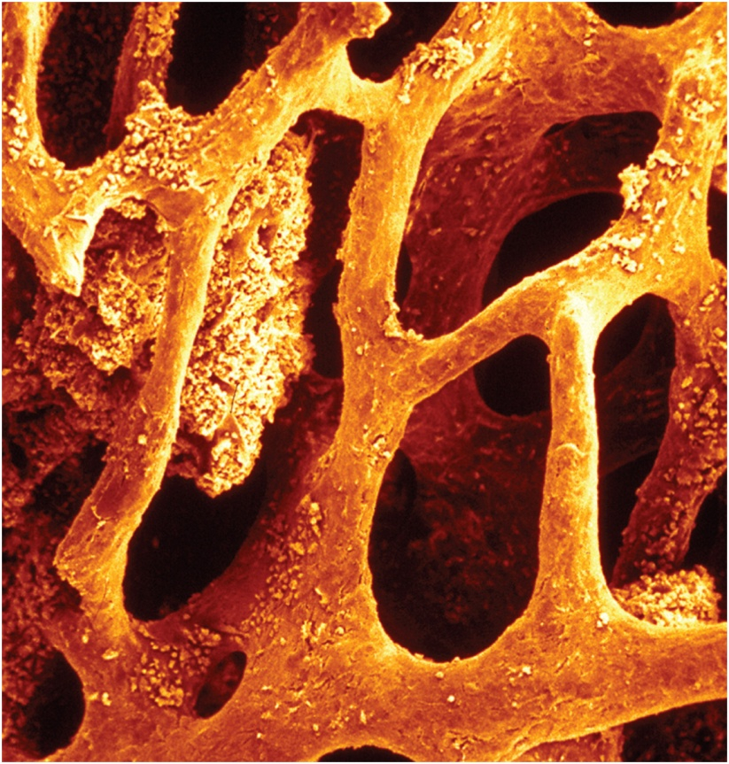
THE SKELETAL SYSTEM I
Al-Farabi Kazakh National University
Higher School of Medicine

Slide 2
LEARNING OUTCOMES
As a result of the lesson you will be able to:
State functions of the skeletal system;
Describe the general features of a long bone and a flat bone;
Describe briefly the process of bone formation in the fetus, and summarize the events of bone remodeling throughout life.
Discuss the role of the bones in Mineral Homeostasis.
Name the main hormones that regulate bone physiology, and describe their effects;

Slide 3
Before we go on
Suppose you had unlabeled electron micrographs of the four kinds of bone cells and their neighboring tissues. Name the four cells and explain how you could visually distinguish each one from the other three.
What are the two kinds of bone marrow? What does hemopoietic tissue mean? Which type of bone marrow fits this description?
Al-Farabi Kazakh National University
Higher School of Medicine

Slide 4
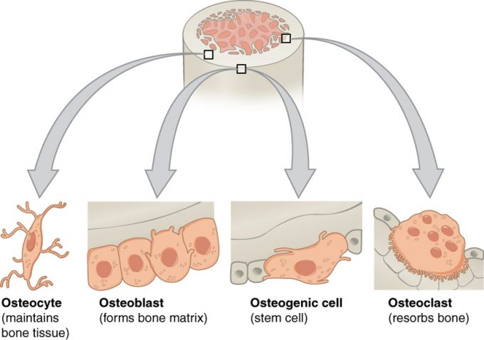
Al-Farabi Kazakh National University
Higher School of Medicine

Slide 5
Bone Cells
Cell type | Function | Location
Osteogenic | Develop into osteoblasts | Endosteum, cellular layer of the periosteum
Osteoblasts | Bone formation | Endosteum, cellular layer of the periosteum, growing portions of bone
Osteocytes | Maintain mineral concentration of matrix | Entrapped in matrix
Osteoclasts | Bone resorption | Endosteum, cellular layer of the periosteum, at sites of old, injured, or unneeded bone
Al-Farabi Kazakh National University
Higher School of Medicine

Slide 6
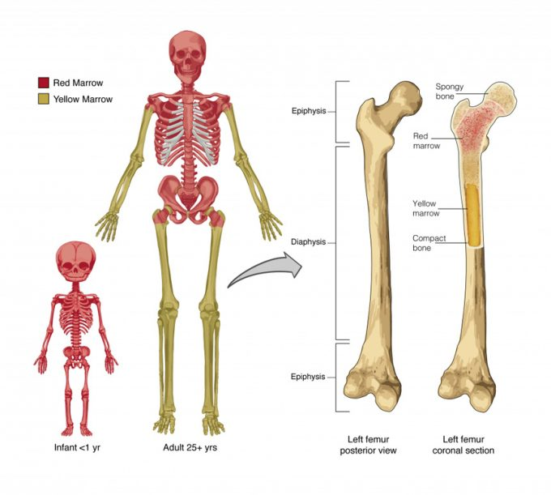
Al-Farabi Kazakh National University
Higher School of Medicine

Slide 7
Bone as a Tissue
osteology – the study of bone
skeletal system - composed of bones, cartilages, and ligaments
form strong flexible framework of the body
cartilage – forerunner of most bones
covers many joint surfaces of mature bone
ligaments – hold bones together at the joints
tendons – attach muscle to bone
Al-Farabi Kazakh National University
Higher School of Medicine

Slide 8
Bones and Osseous Tissue
bone (osseous tissue) - connective tissue with the matrix hardened by calcium phosphate and other minerals
mineralization or calcification – the hardening process of bone
individual bones consist of bone tissue, bone marrow, cartilage, adipose tissue, nervous tissue, and fibrous connective tissue
continually remodels itself and interacts physiologically with all of the other organ systems of the body
permeated with nerves and blood vessels, which attests to its sensitivity and metabolic activity
Al-Farabi Kazakh National University
Higher School of Medicine

Slide 9
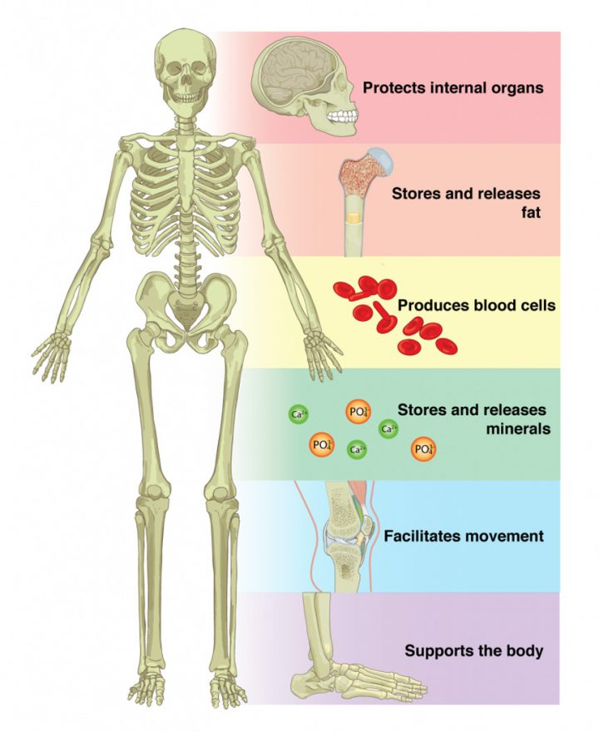
1.
Suppose your red bone marrow could not be formed. What functions would your body not be able to perform?
2.
Suppose your osseous tissue could not store calcium. What functions would your body not be able to perform?
Al-Farabi Kazakh National University
Higher School of Medicine

Slide 10
Functions of the Skeleton
support – hold the body up, supports muscles, mandible and maxilla support teeth
protection – brain, spinal cord, heart, lungs
movement – limb movements, breathing, action of muscle on bone
electrolyte balance – calcium and phosphate ions
acid-base balance – buffers blood against excessive pH changes
blood formation – red bone marrow is the chief producer of blood cells
Al-Farabi Kazakh National University
Higher School of Medicine

Slide 11
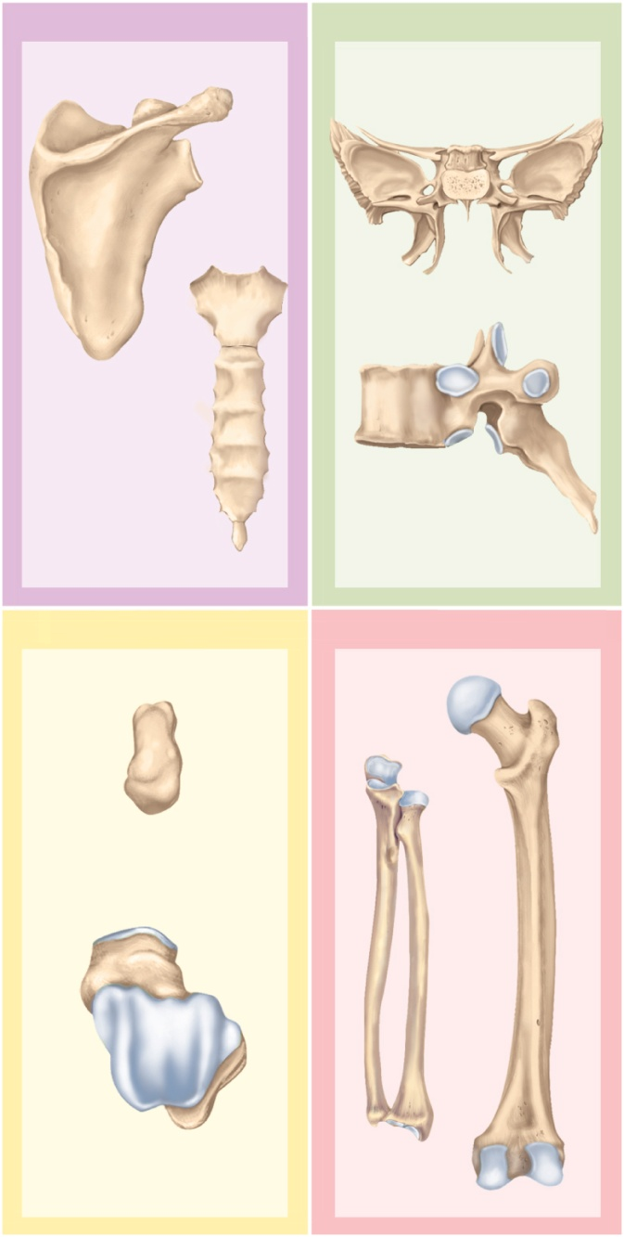
Shapes of Bones
Copyright © The McGraw-Hill Companies, Inc. Permission required for reproduction or display.
Flat bones
Irregular bones
long bones
longer than wide
rigid levers acted upon by muscles
short bones
equal in length and width
glide across one another in multiple directions
flat bones
protect soft organs
curved but wide & thin
irregular bones
elaborate shapes that don’t fit into the other categories
Sphenoid bone
Scapula
Vertebra
Sternum
Short bones
Long bones
Femur
Ulna
Capitate
(carpal) bone
Talus
Radius
Figure 7.1

Slide 12
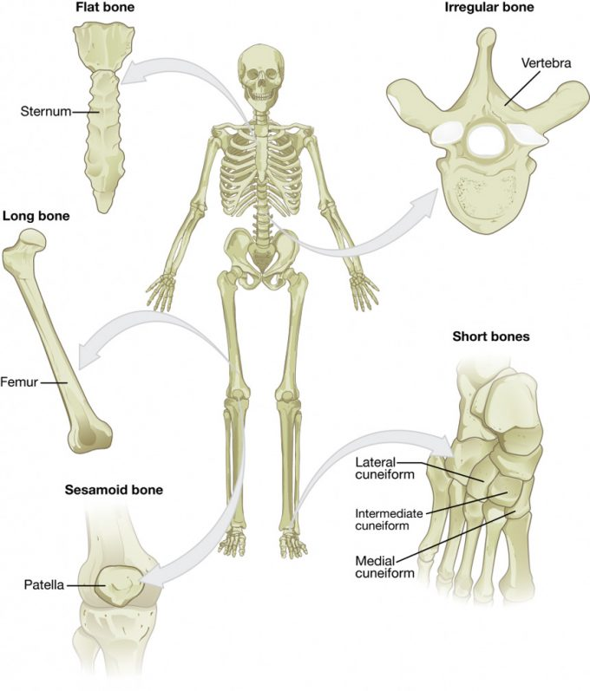
3.
What are the structural and functional differences between a tarsal and a metatarsal?
4.
What are the structural and functional differences between the femur and the patella?
Al-Farabi Kazakh National University
Higher School of Medicine

Slide 13
classification | Features | Function(s) | Examples
Long | Longer than wide Rigid levers acted upon by muscles | Movement, support | Femur, tibia, fibula, metatarsals, humerus, ulna, radius, metacarpals, phalanges
Short | approximately equal in length, width, and thickness | Provide stability, support, while allowing for some motion | Carpals, tarsals
Flat | Thin and curved | Points of attachment for muscles; protectors of internal organs | Sternum, ribs, scapulae, cranial bones
Irregular | Complex shape | Protect internal organs, movement, support | Vertebrae, facial bones
Sesamoid | Small and round; embedded in tendons | Protect tendons from excessive forces, allow effective muscle action | Patellae
Al-Farabi Kazakh National University
Higher School of Medicine

Slide 14
General Features of Bones
compact (dense) bone – outer shell of long bone
diaphysis (shaft) - cylinder of compact bone to provide leverage
medullary cavity (marrow cavity) - space in the diaphysis of a long bone that contains bone marrow
epiphyses - enlarged ends of a long bone
enlarged to strengthen joint and attach ligaments and tendons
spongy (cancellous) bone covered by more durable compact bone
skeleton about three-fourths compact and one-fourth spongy bone by weight
spongy bone found in ends of long bones, and the middle of nearly all others
articular cartilage – a layer of hyaline cartilage that covers the joint surface where one bone meets another
allows joint to move more freely and relatively friction free
nutrient foramina – minute holes in the bone surface that allows blood vessels to penetrate
Al-Farabi Kazakh National University
Higher School of Medicine

Slide 15
General Features of Bones
periosteum – external sheath that covers bone except where there is articular cartilage
outer fibrous layer of collagen
some outer fibers continuous with the tendons that attach muscle to bone
perforating (Sharpey’s) fibers – other outer fibers that penetrate into the bone matrix
strong attachment and continuity from muscle to tendon to bone
inner osteogenic layer of bone forming cells
important to growth of bone and healing of fractures
endosteum – thin layer of reticular connective tissue lining marrow cavity
has cells that dissolve osseous tissue and others that deposit it
epiphyseal plate (growth plate) – area of hyaline cartilage that separates the marrow spaces of the epiphysis and diaphysis
enables growth in length
epiphyseal line – in adults, a bony scar that marks where growth plate used to be
Al-Farabi Kazakh National University
Higher School of Medicine

Slide 16
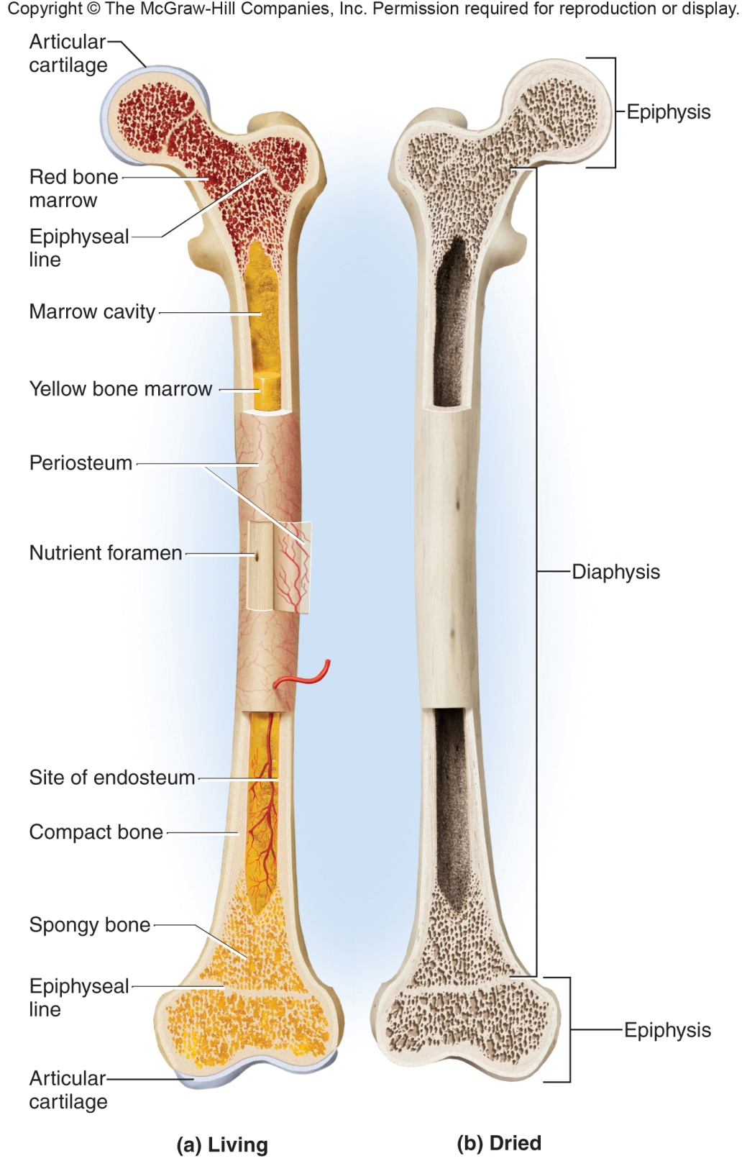
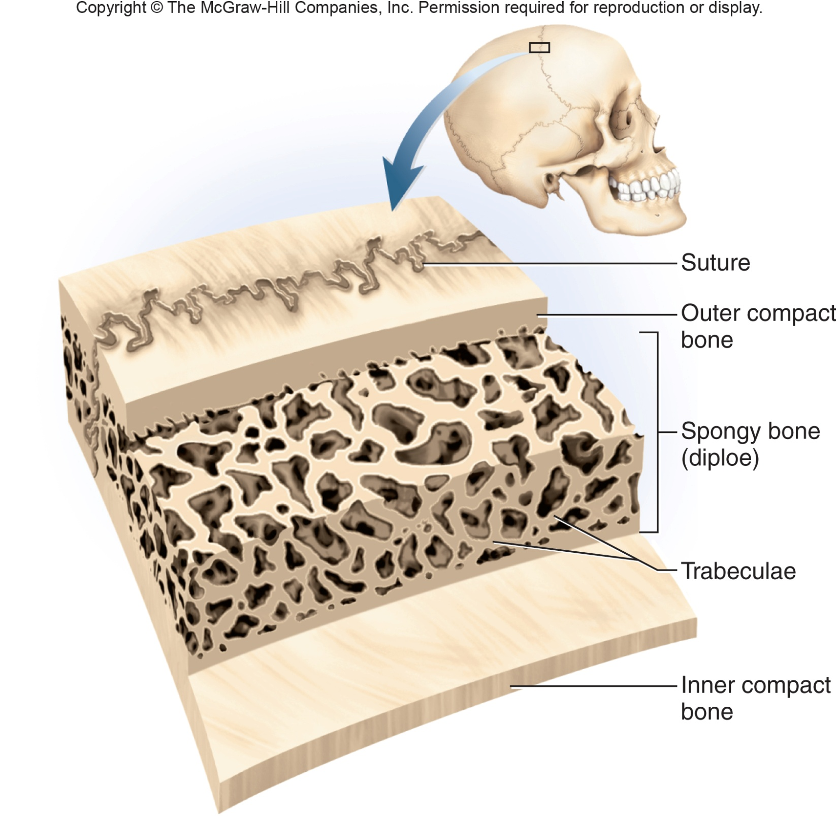
5. What is the functional significance of a long bone being wider at the epiphyses than at the diaphysis?
6.Explain the difference between compact and spongy bone, and describe their spatial relationship to each other in a long bone and a flat bone.
Al-Farabi Kazakh National University
Higher School of Medicine

Slide 17
Bone Development
ossification or osteogenesis – the formation of bone
in the human fetus and infant, bone develops by two methods:
intramembranous ossification
endochondral ossification

Slide 18
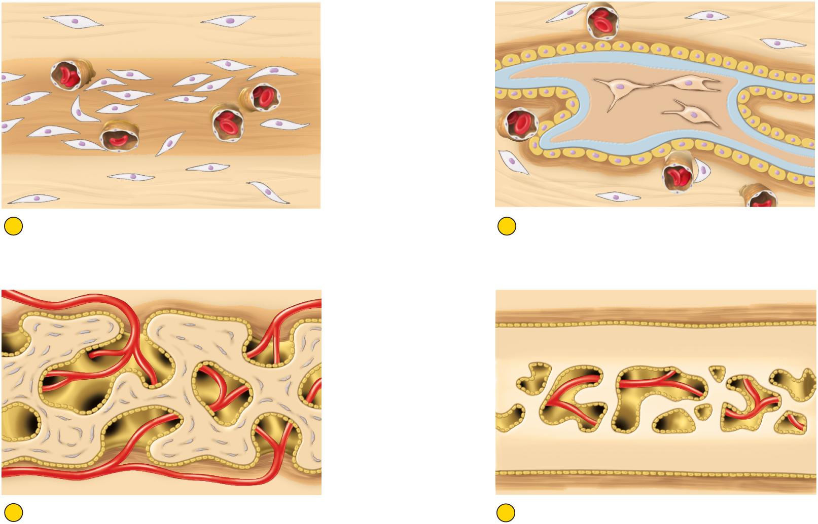
Intramembranous Ossification
Copyright © The McGraw-Hill Companies, Inc. Permission required for reproduction or display.
Mesenchymal cell
Osteocyte
Osteoblasts
Sheet of condensing
mesenchyme
Trabecula
Calcified bone
Blood capillary
Osteoid tissue
Fibrous periosteum
1
Condensation of mesenchyme into soft sheet
permeated with blood capillaries
2
Deposition of osteoid tissue by osteoblasts
on mesenchymal surface; entrapment of first
osteocytes; formation of periosteum
Osteoblasts
Fibrous periosteum
T
rabeculae
Osteoblasts
Osteocytes
Spongy bone
Marrow cavity
Compact bone
3
Honeycomb of bony trabeculae formed by
continued mineral deposition; creation of
spongy bone
4
Surface bone filled in by bone deposition,
converting spongy bone to compact bone.
Persistence of spongy bone in the middle layer.
Figure 7.8
produces flat bones of skull and clavicle

Slide 19
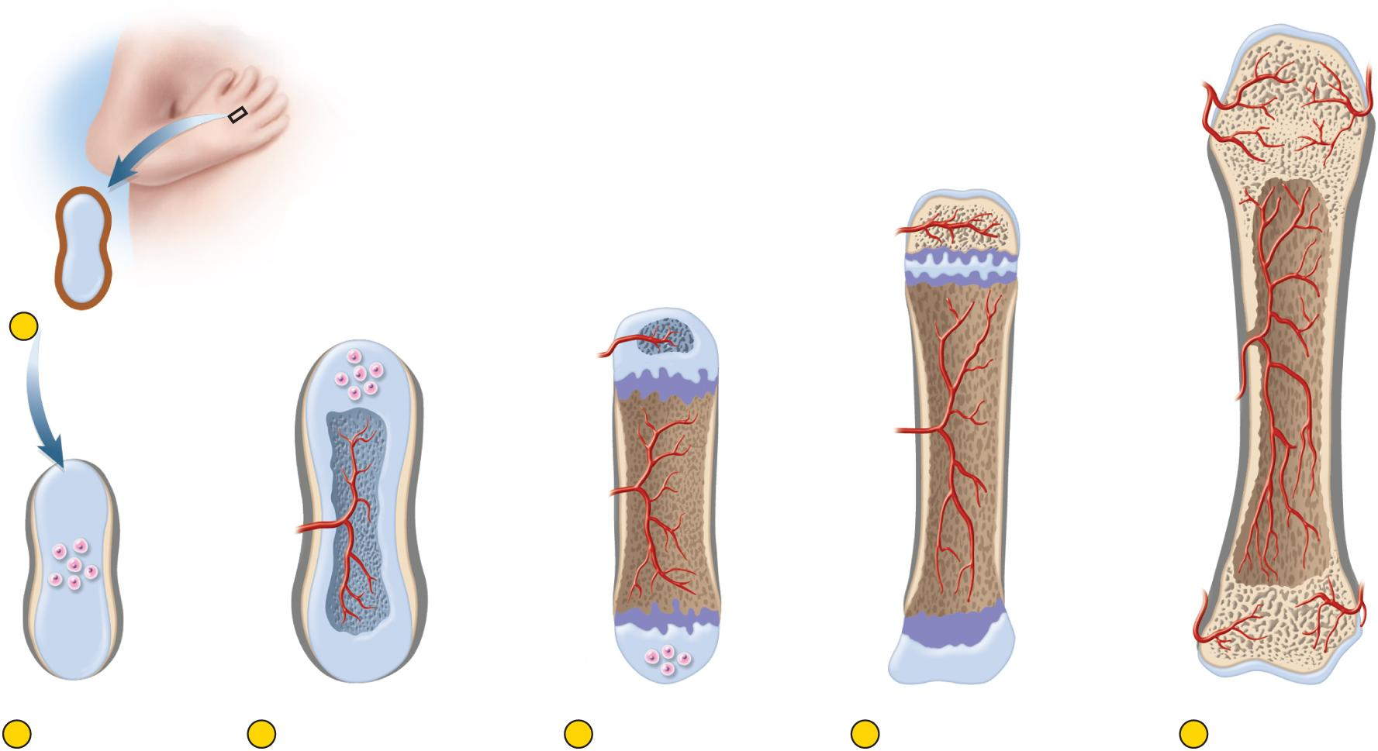
Stages of Endochondral Ossification
Copyright © The McGraw-Hill Companies, Inc. Permission required for reproduction or display.
Articular
cartilage
Spongy bone
Epiphyseal
line
Perichondrium
Hyaline
cartilage
Secondary
marrow cavity
Epiphyseal
plate
Periosteum
1
Early cartilage model
Epiphysis
Nutrient
foramen
Secondary
ossification
center
Marrow cavity
Metaphysis
Compact bone
Enlarging
chondrocytes
Blood
vessel
Bony collar
Diaphysis
Primary
marrow
cavity
Primary
ossification
center
Secondary
ossification
center
Metaphysis
Periosteum
Cartilage
2
Formation of
primary
ossification center,
bony collar, and
periosteum
3
Vascular invasion,
formation of primary
marrow cavity, and
appearance of
secondary
ossification center
4
Bone at birth, with
enlarged primary
marrow cavity and
appearance of
secondary marrow
cavity in one epiphysis
5
Bone of child, with
epiphyseal plate at
distal end
6
Adult bone with a
single marrow
cavity and closed
epiphyseal plate
Figure 7.10

Slide 20
Mini case
part A:
A race between two runners is often used as an analogy to describe the mechanism of endochondral ossification. Review endochondral ossification. In endochondral ossification, who are the two runners? Did each runner begin the race at the same time? Who is in the lead? How does the race end?
Al-Farabi Kazakh National University
Higher School of Medicine

Slide 21
Mini case
part B:
What roles do osteoclasts and osteocytes play in endochondral ossification?
Al-Farabi Kazakh National University
Higher School of Medicine
Notes:
While the osteoclasts and osteocytes do not participate in the race at the epiphyseal plate, they do play essential roles. Osteoclasts are cells that remove and recycle bone matrix. In endochondral ossification, osteoclasts erode bone in the center of the diaphysis, creating the medullary cavity.
When an osteoblast is completely surrounded by bone matrix, it differentiates into an osteocyte. Osteocytes regulate endochondral ossification by monitoring and maintaining the protein and mineral content of the surrounding matrix. Interestingly, an osteocyte can return to an osteoblast if needed.

Slide 22
Mini case
part C:
8-year old Sandra breaks her left leg in a car accident. X-rays indicate that her left femur is fractured at the epiphyseal plate. The bone fracture eventually heals. Years later, Sandra begins to notice that her right leg is slightly longer than her left leg. What might account for the difference in length between Sandra’s two legs? Explain Sandra’s condition with respect to the race that you described in part A.
Al-Farabi Kazakh National University
Higher School of Medicine
Notes:
Sandra fractured her bone at the epiphyseal plate, thus damaging the epiphyseal cartilage. Because cartilage is avascular, it repairs much more slowly than osseous tissue, which is highly vascular. Therefore, even though the bone healed properly, Sandra’s left leg did not produce as much cartilage as her right, undamaged, leg. With respect to the race, the injury caused the chondroblasts to slow down in the damaged leg. Therefore, by the time the osteoblasts caught up to the chondroblasts, the chondroblasts had run a shorter distance in the damaged left leg. Because the chondroblasts are responsible for bone lengthening, the result would be a shorter left leg.

Slide 23
Mini case
part D:
20-year old Sandra begins to worry about her lopsided legs. She wonders if her right leg will continue to grow longer than her left. Sandra consults a doctor who takes an x-ray of each of her femurs. After the x-ray, the doctor informs Sandra that she has reached full height; she should expect no further difference in length between the two legs. How did the doctor use the x-rays to determine that Sandra had reached full height?
Al-Farabi Kazakh National University
Higher School of Medicine

Slide 24
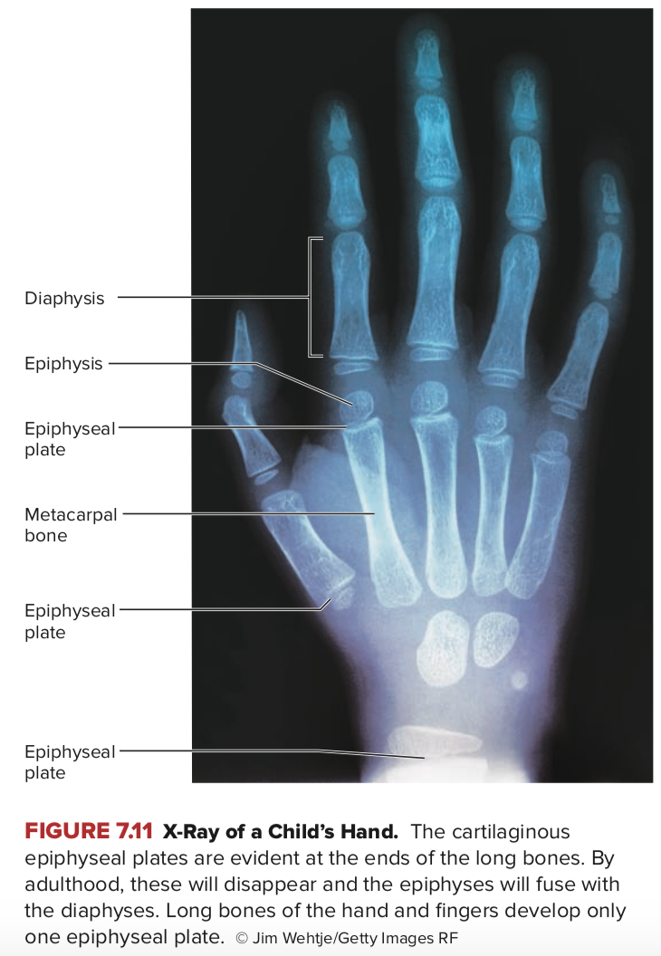
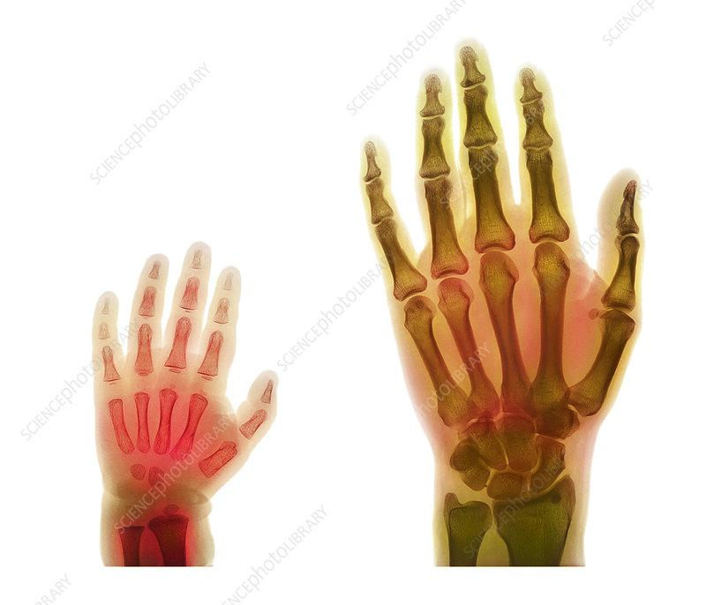
Al-Farabi Kazakh National University
Higher School of Medicine

Slide 25
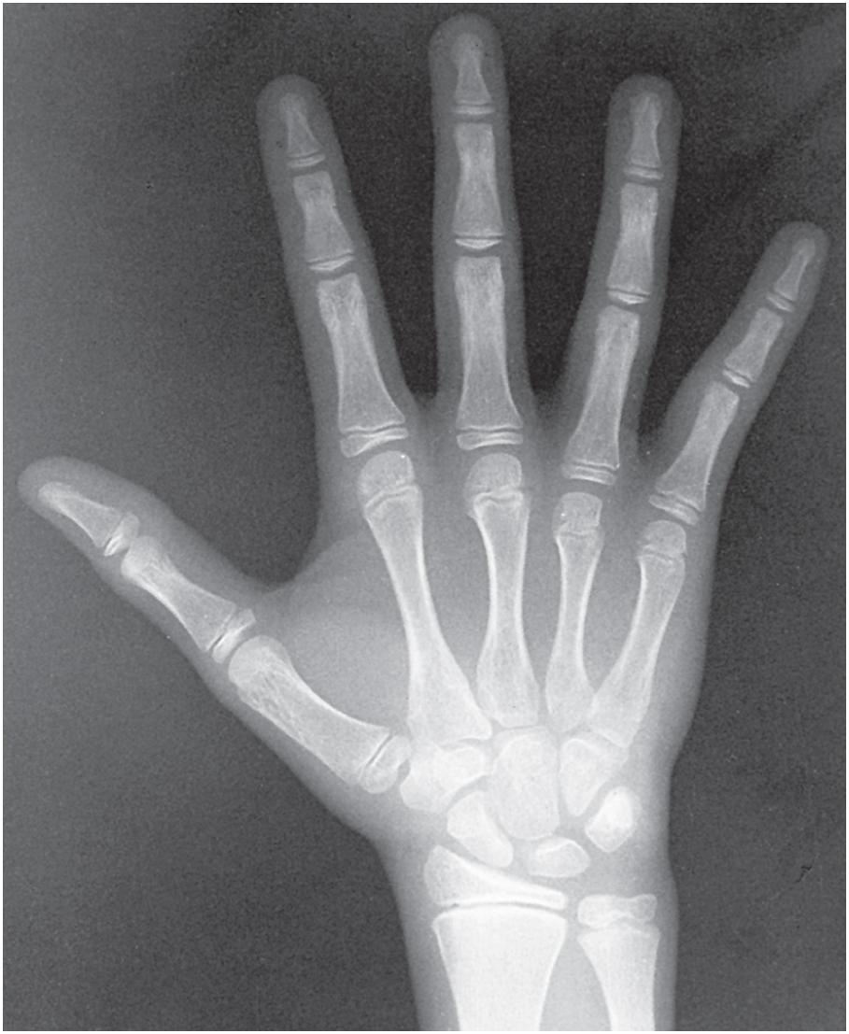
Cartilaginous Epiphyseal Plates
Copyright © The McGraw-Hill Companies, Inc. Permission required for reproduction or display.
Diaphysis
Epiphysis
Epiphyseal
plate
Metacarpal
bone
Epiphyseal
plates
Figure 7.12
Courtesy of Utah Valley Regional Medical Center, Department of Radiology

Slide 26
Endochondral Ossification
part D:
If long bones are still growing in length, an x-ray should reveal a plate of cartilage that separates the epiphysis from the diaphysis (the epiphyseal plate). If long bones have stopped growing, the epiphyseal plate is replaced by an epiphyseal line (scar), which remains after bone lengthening has ended. Sandra’s x-ray must have shown an epiphyseal line (scar), indicating that her femur had reached full length.
Al-Farabi Kazakh National University
Higher School of Medicine

Slide 27
Bone Growth and Remodeling
What is Orthodontic Tooth Movement? Why dentists are able to move teeth during orthodontic treatment?
Which bone cells is important during orthodontic treatment?why?
Describe the role of remodeling in orthodontics?
Al-Farabi Kazakh National University
Higher School of Medicine

Slide 28
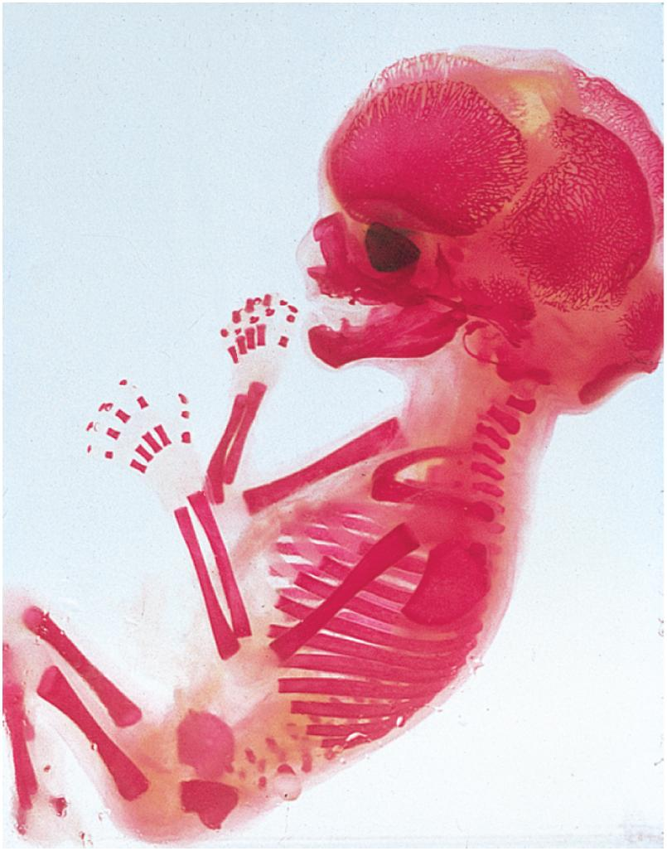
Fetal Skeleton at 12 Weeks
Copyright © The McGraw-Hill Companies, Inc. Permission required for reproduction or display.
Cranial
bones
Mandible
Humerus
Vertebrae
Radius
Ulna
Scapula
Ribs
Femur
Pelvis
Figure 7.11
© Biophoto Associates/Photo Researchers, Inc.

Slide 29
Physiology of Osseous Tissue
a mature bone remains a metabolically active organ
involved in its own maintenance of growth and remodeling
exerts a profound influence over the rest of the body by exchanging minerals with tissue fluid
disturbance of calcium homeostasis in skeleton disrupts function of other organ systems
especially nervous and muscular
Al-Farabi Kazakh National University
Higher School of Medicine

Slide 30
Ion Imbalances
hypercalcemia is rare
hypocalcemia has a wide variety of causes
vitamin D deficiency
diarrhea
thyroid tumors
underactive parathyroids
pregnancy and lactation
accidental removal of parathyroid glands during thyroid surgery
calcium homeostasis depends on a balance between dietary intake, urinary and fecal loses, and exchanges between osseous tissue
calcium homeostasis is regulated by three hormones:
calcitriol, calcitonin, and parathyroid hormone
Al-Farabi Kazakh National University
Higher School of Medicine

Slide 31
Mini-Case II Hormones & Bone Growth
part A:
6-year old Jose inherited a disorder that increases the activity of cells in his pituitary gland. Therefore, Jose experiences an overproduction of growth hormone (GH) before puberty. What effect would you predict this will have on his height? Explain.
Al-Farabi Kazakh National University
Higher School of Medicine
Notes:
GH increases the activity of both the chondroblasts and the osteoblasts. Therefore, Jose s will likely be taller than disorder will cause his bones to grow at a faster rate and Jose normal. An overactive pituitary is one cause of gigantism. Gigantism is abnormally large growth due to an excess of growth hormone during childhood. A pituitary tumor is another common cause of gigantism. The tallest individual in the world has pituitary gigantism and stands at 8 feet 1 inch.

Slide 32
Hormones& Bone Growth
Russell enters puberty ~5 years later than average age. What effect would you predict this will have on his height? Explain.
part B:
Al-Farabi Kazakh National University
Higher School of Medicine
Notes:
Russell would grow throughout childhood and stop growing at puberty with the closure of the epiphyseal plate. The later puberty begins, the later growth would end. Therefore, by the time Russell reaches puberty, he would most likely be taller than normal (he had a longer period of time to grow).

Slide 33
Hormones& Bone Growth
A race between two runners is often used as an analogy to describe the mechanism of endochondral ossification. Review endochondral ossification. How does each of the above cases relate to the “race” during endochondral ossification?
part C:
Al-Farabi Kazakh National University
Higher School of Medicine

Slide 34
Hormones& Bone Growth
part D:
Form a hypothesis for why adult women are typically shorter than adult men.
Al-Farabi Kazakh National University
Higher School of Medicine

Slide 35
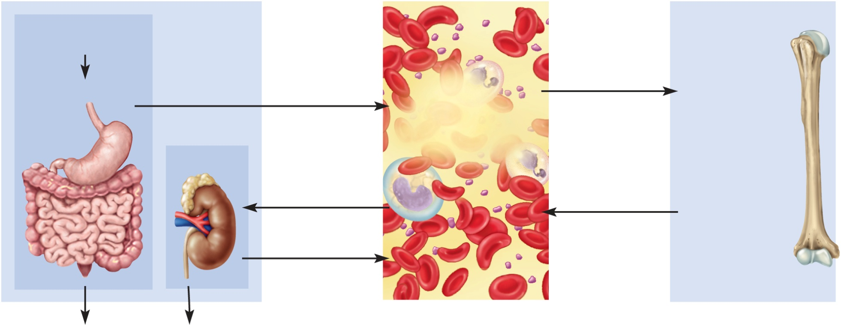
Hormonal Control of Calcium
Copyright © The McGraw-Hill Companies, Inc. Permission required for reproduction or display.
Calcium Intake and Excretion
Blood
Bone
Dietary requirement
1,000 mg/day
Deposition by
osteoblasts
Digestive tract
Absorption by
digestive tract
Calcitonin
(weak effect)
Calcitriol
Ca²⁺
(9.2–10.4 mg/dL)
Hydroxyapatite
Ca₁₀(PO₄)₆(OH)₂
Kidneys
Calcium carbonate
CaCO₃
Filtration
by kidneys
Resorption by
osteoclasts
Calcitriol
PTH
Reabsorption
by kidneys
Calcitriol
(weak effect)
PTH
Fecal loss
350 mg/day
Urinary loss
650 mg/day
Figure 7.17
calcitriol, calcitonin, and PTH maintain normal blood calcium concentration

Slide 36
Calcitriol (Activated Vitamin D)
calcitriol – a form of vitamin D produced by the sequential action of the skin, liver, and kidneys
produced by the following process:
epidermal keratinocytes use UV radiation to convert a steroid, 7-dehydrocholesterol to previtamin D₃
liver adds a hydroxyl group converting it to calcidiol
kidneys adds another hydroxyl group, converting that to calcitriol
(most active form of vitamin D) – also from fortified milk
calcitriol behaves as a hormone that raises blood calcium concentration
increases calcium absorption by small intestine
increases calcium resorption from the skeleton
increases stem cell differentiation into osteoclasts which liberates calcium and phosphate from bone
promotes kidney reabsorption of calcium ions, so less lost in urine
necessary for bone deposition – need adequate calcium and phosphate
abnormal softness of bones (rickets) in children and (osteomalacia) in adults without adequate vitamin D

Slide 37
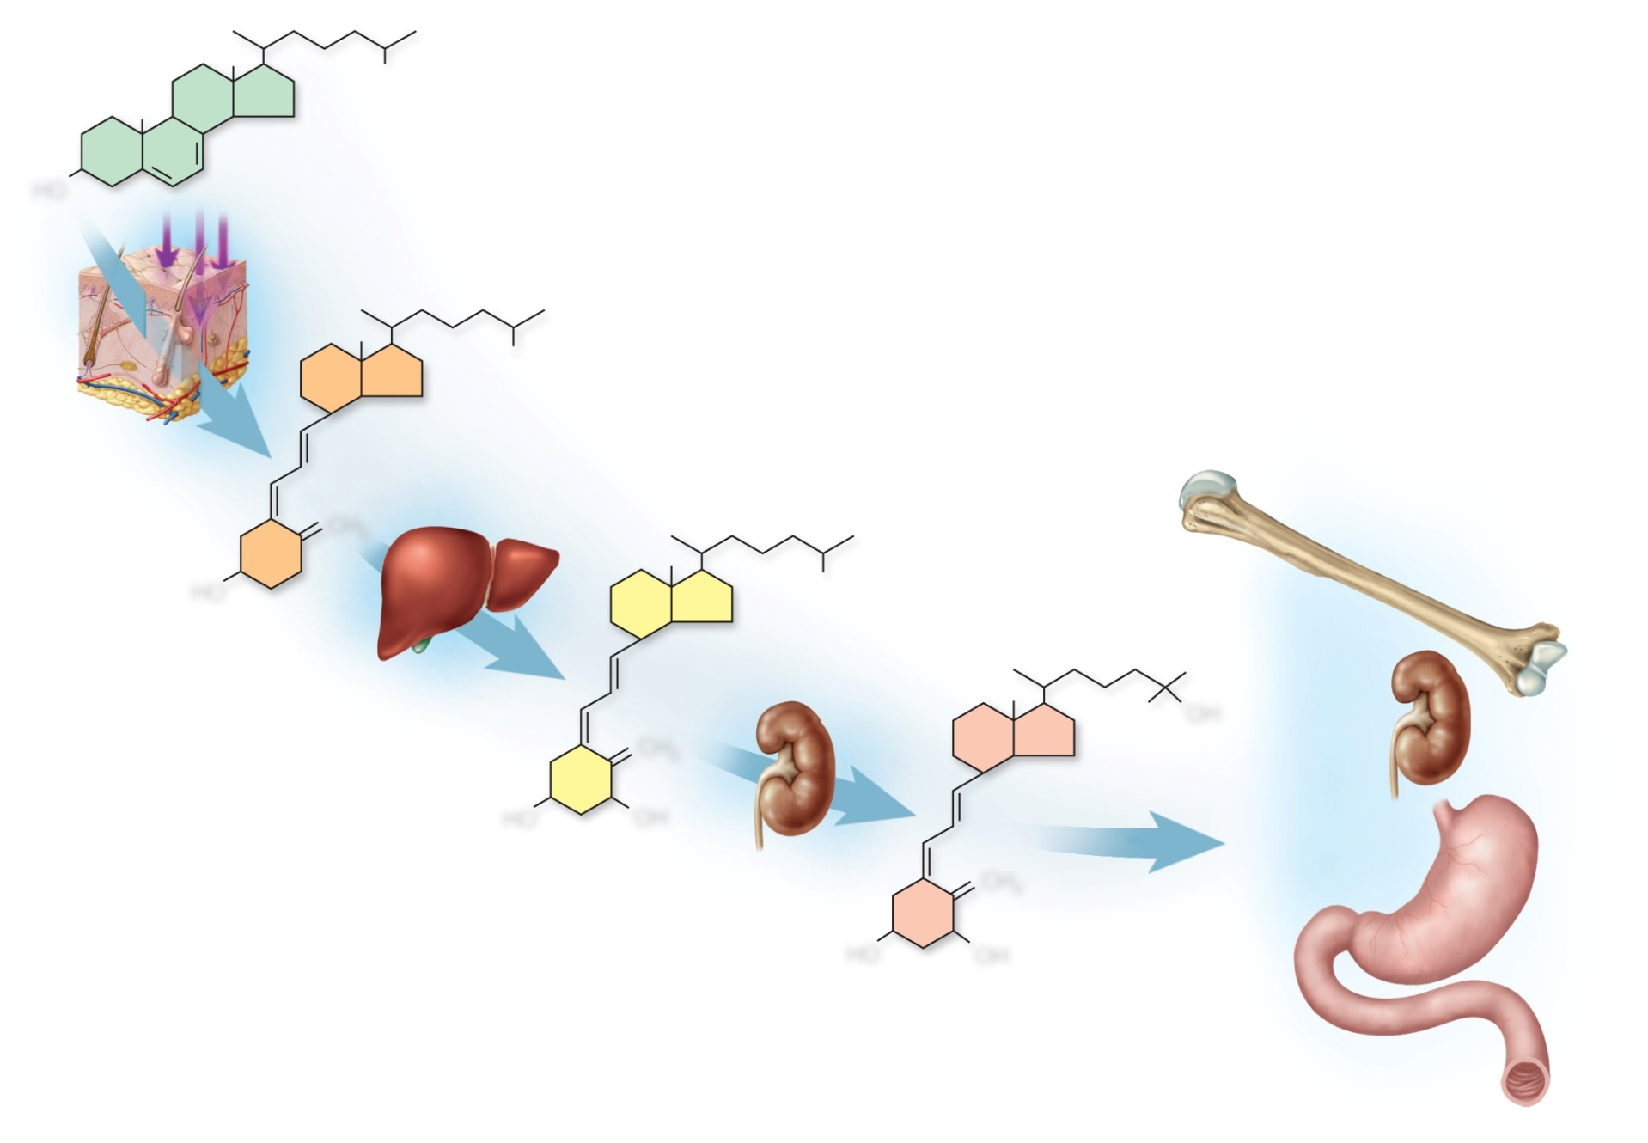
Calcitriol Synthesis and Action
Copyright © The McGraw-Hill Companies, Inc. Permission required for reproduction or display.
7-dehydrocholesterol
HO
Ultraviolet
light
Vitamin D₃
(cholecalciferol)
CH₂
HO
Bone
resorption
Calcidiol
OH
Reduced
excretion
of Ca²⁺
CH₂
HO
OH
Calcitriol
Absorption
of Ca²⁺ and
phosphate
CH₂
HO
OH
Figure 7.16

Slide 38
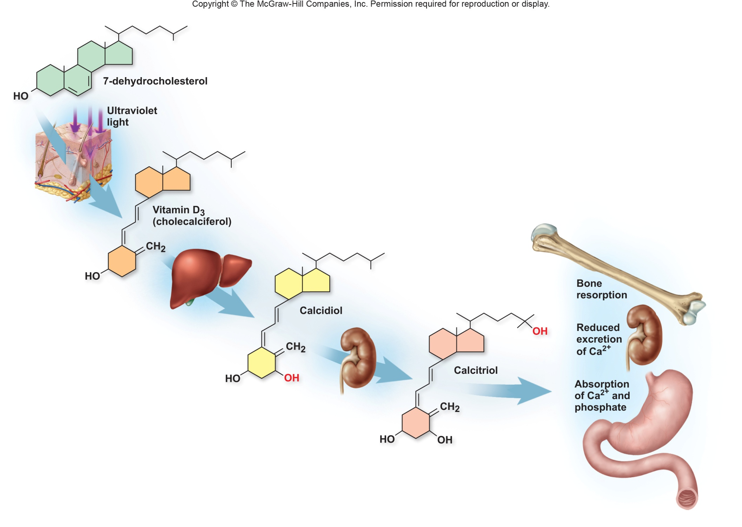
An individual with very low levels of vitamin D presents themselves to you complaining of seemingly fragile bones. Explain how these might be connected.
Al-Farabi Kazakh National University
Higher School of Medicine

Slide 39
Calcitonin
calcitonin - secreted by C cells (clear cells) of the thyroid gland when calcium concentration rises too high
lowers blood calcium concentration in two ways:
osteoclast inhibition
reduces osteoclast activity as much as 70%
less calcium liberated from bones
osteoblast stimulation
increases the number and activity of osteoblasts
deposits calcium into the skeleton
important in children, weak effect in adults
osteoclasts more active in children due to faster remodeling
deficiency does not cause disease in adults
reduces bone loss in women during pregnancy & lactation

Slide 40
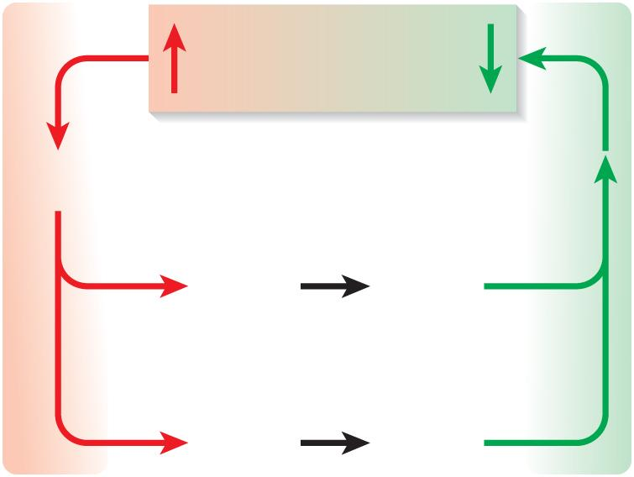
Correction for Hypercalcemia
Copyright © The McGraw-Hill Companies, Inc. Permission required for reproduction or display.
Blood Ca²⁺
excess
Blood Ca²⁺
returns to
normal
Calcitonin
secretion
Reduced
osteoclast
activity
Less bone
resorption
Increased
osteoblast
activity
More bone
deposition
Figure 7.18a
(a) Correction for hypercalcemia

Slide 41
Parathyroid Hormone
parathyroid hormone (PTH) – secreted by the parathyroid glands which adhere to the posterior surface of thyroid gland
PTH released with low calcium blood levels
PTH raises calcium blood level by four mechanisms
binds to receptors on osteoblasts
stimulating them to secrete RANKL which raises the osteoclast population
promotes calcium reabsorption by the kidneys, less lost in urine
promotes the final step of calcitriol synthesis in the kidneys, enhancing calcium raising effect of calcitriol
inhibits collagen synthesis by osteoblasts, inhibiting bone deposition
sporadic injection or secretion of low levels of PTH causes bone deposition, and can increase bone mass
Al-Farabi Kazakh National University
Higher School of Medicine

Slide 42
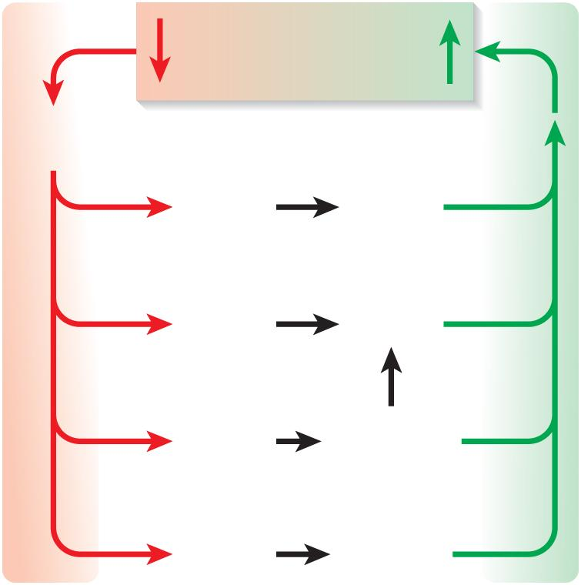
Correction for Hypocalcemia
Copyright © The McGraw-Hill Companies, Inc. Permission required for reproduction or display.
Blood Ca²⁺
deficiency
Blood Ca²⁺
returns to
normal
Parathyroid
hormone
secretion
Increased
osteoclast
activity
More bone
resorption
Reduced
osteoblast
activity
Less bone
deposition
More urinary
phosphate
excretion
Prevention of
hydroxyapatite
formation
Figure 7.18b
Less urinary
calcium
excretion
Conservation
of calcium
(b) Correction for hypocalcemia

Slide 43
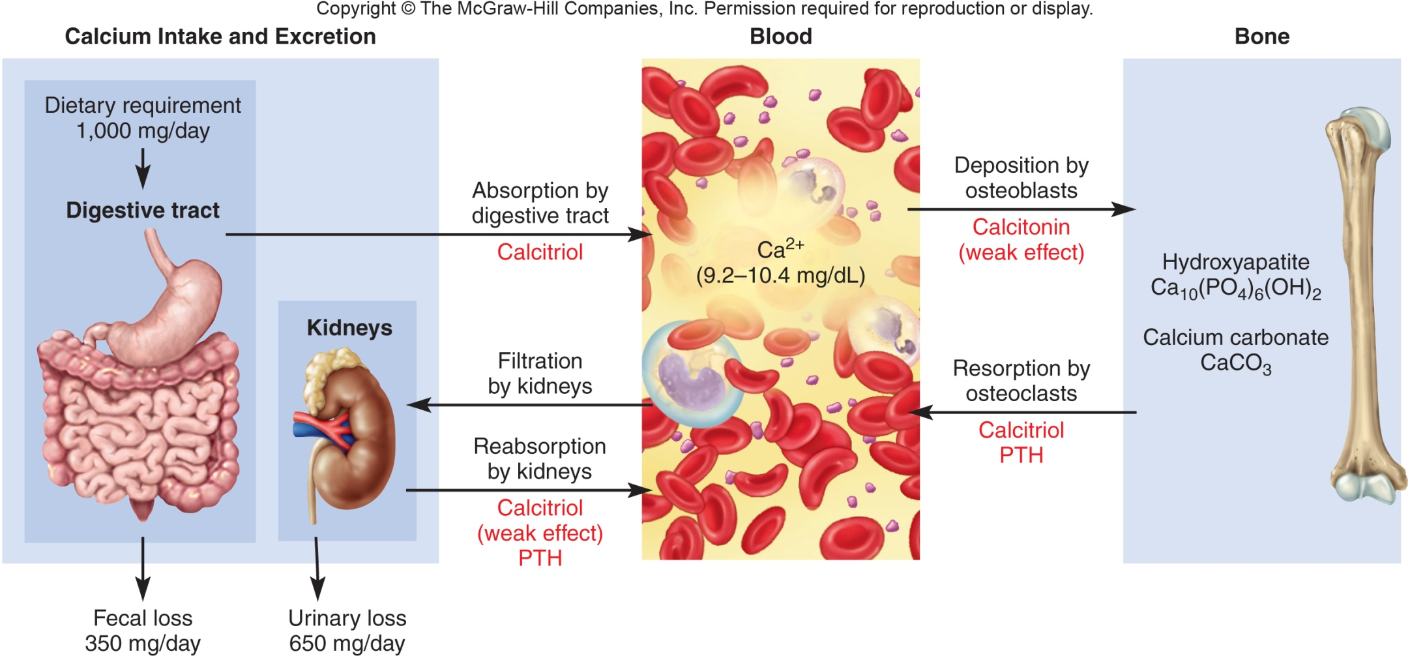
Describe the effects caused when the parathyroid gland fails to respond to calcium bound to its receptors.
Al-Farabi Kazakh National University
Higher School of Medicine

Slide 44
Under “normal” conditions, receptors in the parathyroid glands bind blood calcium. When the receptors are full, the parathyroid gland stops secreting PTH.
In the condition described, the parathyroid glands are not responding to the signal that there is sufficient calcium in the blood and they keep releasing PTH, which causes the bone to release more calcium into the blood.
Ultimately, the bones become fragile and hypercalcemia can result.
Al-Farabi Kazakh National University
Higher School of Medicine

Slide 45
Physiology of Osseous Tissue
part A:
Markus has a vitamin D₃ deficiency. How might this affect Markus’s blood calcium levels? How might this affect Markus’s bone density? Explain.
Al-Farabi Kazakh National University
Higher School of Medicine

Slide 46
Physiology of Osseous Tissue
part B:
Markus’s doctor performs a blood test. The test results suggest that Markus has normal levels of calcium in is his blood, despite his vitamin D3 deficiency. What might account for Markus’s normal blood calcium levels? What does this suggest about Markus’s bone density?
Al-Farabi Kazakh National University
Higher School of Medicine

Slide 47
Physiology of Osseous Tissue
part C:
45-year old Fabiola has been experiencing osteopenia for the last ~15 years. Therefore, she regularly visits her doctor for bone mineral density (BMD) tests. At her most recent visit, Fabiola’s doctor tells her that her osteopenia may develop into osteoporosis. What causes osteopenia? What causes osteoporosis? What is the difference between osteopenia and osteoporosis?
Al-Farabi Kazakh National University
Higher School of Medicine

Slide 48
Physiology of Osseous Tissue
part D:
Fabiola’s doctor suggests hormone replacement therapy (HRT) to decrease Fabiola’s risk of developing osteoporosis. What is HRT? How does HRT decrease the risk of developing osteoporosis?
Al-Farabi Kazakh National University
Higher School of Medicine

Slide 49
Physiology of Osseous Tissue
part E:
Fabiola’s doctor explains that HRT is not for everyone; it has potential side- effects such as increased risk of breast cancer. Because breast cancer runs in Fabiola’s family, she should also consider other alternatives. Describe at least two other options that can help prevent osteoporosis.
Al-Farabi Kazakh National University
Higher School of Medicine

Slide 50
Physiology of Osseous Tissue
part F:
Fabiola asks her doctor if her husband should also consider preventative measures to decrease his likelihood of osteoporosis. Fabiola’s doctor suggests that her husband get a BMD test. He also states that women are much more likely to develop osteoporosis than men. Why is osteoporosis more common in aging women than aging men?
Al-Farabi Kazakh National University
Higher School of Medicine

Slide 51
Osteoporosis
osteoporosis – the most common bone disease
severe loss of bone density
bones lose mass and become brittle due to loss of organic matrix and minerals
affects spongy bone the most since it is the most metabolically active
subject to pathological fractures of hip, wrist and vertebral column
kyphosis (widow’s hump) – deformity of spine due to vertebral bone loss
complications of loss of mobility are pneumonia and thrombosis
postmenopausal white women at greatest risk
begin to lose bone mass as early as 35 yoa
by age 70, average loss is 30% of bone mass
risk factors - race, age, gender, smoking, diabetes mellitus, diets poor in calcium, protein, vitamins C and D
Al-Farabi Kazakh National University
Higher School of Medicine

Slide 52
Osteoporosis
estrogen maintains density in both sexes inhibits resorption by osteoclasts
testes and adrenals produce estrogen in men
in women, rapid bone loss after menopause since estrogen blood level drops below 30 ng/mL
osteoporosis is common in young female athletes with low body fat causing them to stop ovulating and ovarian estrogen secretion is low
treatments
estrogen replacement therapy (ERT) slows bone resorption, but increases risk of breast cancer, stroke and heart disease
drugs Fosamax/Actonel destroys osteoclasts
PTH slows bone loss if given as daily injection
Forteo (PTH derivative) increases density by 10% in 1 year
may promote bone cancer so use is limited to 2 years
best treatment is prevention - exercise and calcium intake (1000 mg/day) between ages 25 and 40
Al-Farabi Kazakh National University
Higher School of Medicine

Slide 53
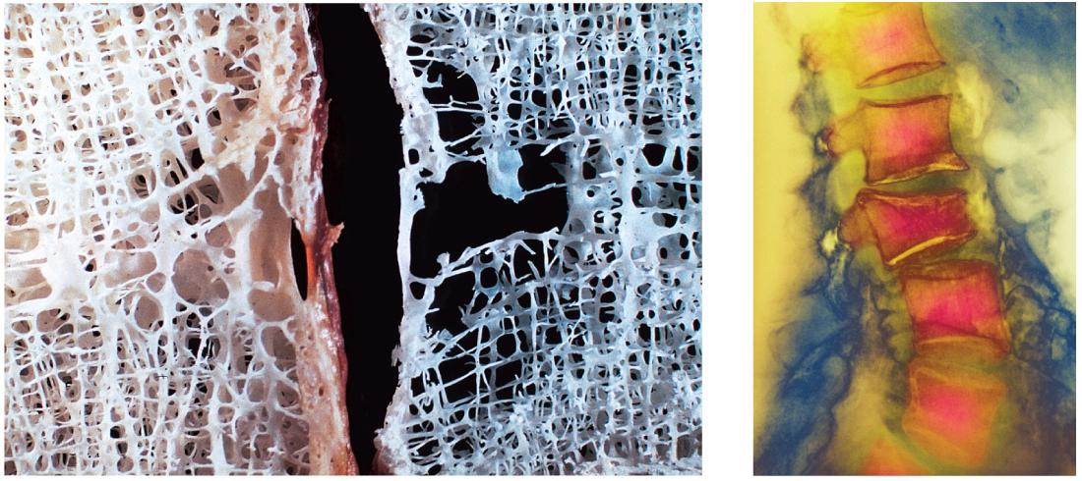
Spinal Osteoporosis
Copyright © The McGraw-Hill Companies, Inc. Permission required for reproduction or display.
(a)
(b)
a: © Michael Klein/Peter Arnold, Inc.; b: © Dr. P. Marzzi/Photo Researchers, Inc.
Figure 7.22 a-b

Slide 54
Post-test:10 min

